Slide 1
An Ontology of Relations for Biomedical Informatics
Barry Smith
10 January 2005

Slide 2
GOAL
Ontology-based integration of biomedical terminologies
SNOMED-CT, FMA, NCI Thesaurus ...
Gene Ontology

Slide 3
The challenge of integrating genetic and clinical data
obstacles:
The associative methodology
The granularity gulf
3. Time

Slide 4
First obstacle: the associative methodology
Ontologies are about word meanings
(‘concepts’, ‘conceptualizations’)

Slide 5
A is_a B =def.
‘A’ is more specific in meaning than ‘B’
meningitis is_a disease of the nervous system
unicorn is_a one-horned mammal
cell is_a cell NOS

Slide 6
The linguistic reading of ‘concept’
yields a smudgy view of reality, built out of relations like:
‘synonymous_with’
‘associated_with’
‘has_been_annotated_with’

Slide 7
Biomedical ontology integration
will never be achieved through integration of meanings or concepts
-- different user communities use different concepts
-- the grid of concepts is too coarse-grained

Slide 8
The concept approach can’t cope at all with relations like
part_of = def. composes, with one or more other physical units, some larger whole
contains =def. is the receptacle for fluids or other substances

Slide 9


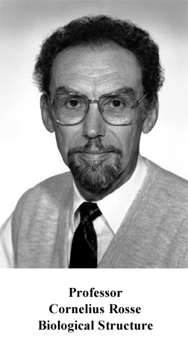
Digital Anatomist
The
first crack
in the wall

Slide 10
The Gene Ontology
Second crack
in the wall
European Bioinformatics Institute, ...
Open source
Transgranular
Cross-Species
Components, Processes, Functions

Slide 11
New GO / OBO Reform Effort
OBO = Open Biological Ontologies

Slide 12
OBO Library
Gene Ontology
MGED Ontology
Cell Ontology
Disease Ontology
Sequence Ontology
Fungal Ontology
Plant Ontology
Mouse Anatomy Ontology
Mouse Development Ontology
...

Slide 13
coupled with
Relations Ontology (IFOMIS)
suite of relations for biomedical ontology to be submitted to CEN as basis for standardization of biomedical ontologies
Donnelly-Bittner alignment of FMA and GALEN

Slide 14
Key idea
To define ontological relations like
part_of, develops_from
not enough to look just at universals / types:
we need also to take account of instances and time
(= link to Electronic Health Record built into the ontology itself)

Slide 15
Kinds of relations
<universal, universal>: is_a, part_of, ...
<instance, universal>: this explosion instance_of the universal explosion
<instance, instance>: Mary’s heart part_of Mary

Slide 16
part_of
for universals
A part_of B =def.
given any instance a of A
there is some instance b of B
such that
a instance-level part_of b

Slide 17
part_of and has_part are equipolent

Slide 18
derives_from
(ovum, sperm → zygote ... )
C
c at t
C₁
c₁ at t₁
time
C'
c' at t
instances

Slide 19
transformation_of
same instance
C
c at t
C₁
c at t₁
time
pre-RNA → mature RNA
child → adult

Slide 20
transformation_of
C₂ transformation_of C₁ =def. any instance of C₂ was at some earlier time an instance of C₁

Slide 21
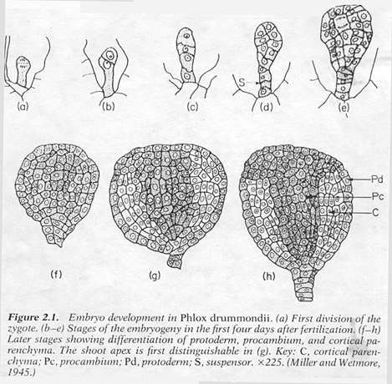
C
c at t
C₁
c at t₁
embryological development

Slide 22
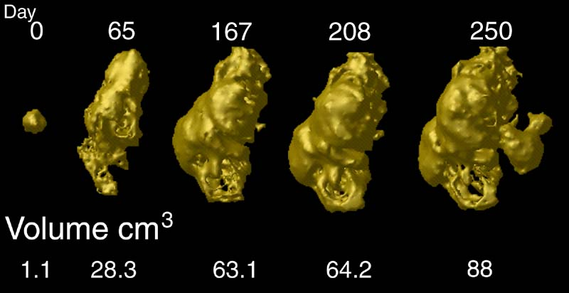
tumor development
C
c at t
C₁
c at t₁
Notes:
http://www.loni.ucla.edu/~thompson/HBM2000/tumor_volumes.jpg

Slide 23
The Granularity Gulf
most existing data-sources are of fixed, single granularity
many (all?) clinical phenomena cross granularities

Slide 24
Universe/Periodic Table
clinical space
molecule space

Slide 25
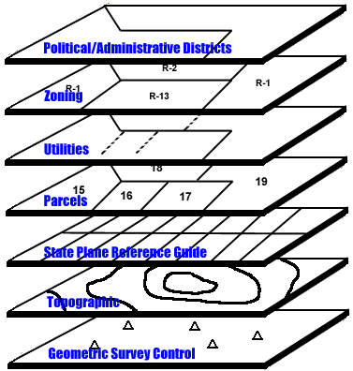
intragranular arcs
contained_in
adjacent_to
has_participant
part_of
contained_in

Slide 26
transgranular arcs
part_of

Slide 27
transformation_of
C
c at t
C₁
c at t₁

Slide 28
time & granularity
c at t₁
C₁
transformation
C
c at t

Slide 29
cancer staging
c at t₁
C₁
transformation
C
c at t

Slide 30
Standardized formal ontology yields:
better data (more reliable coding)
link to EHR via time and instances
better integration of ontologies
more powerful tools for logical reasoning

Slide 31
and help us to integrate information
on the different levels of molecule, cell, organ, person, population
and so create synergy between medical informatics and bioinformatics at all levels of granularity

Slide 32
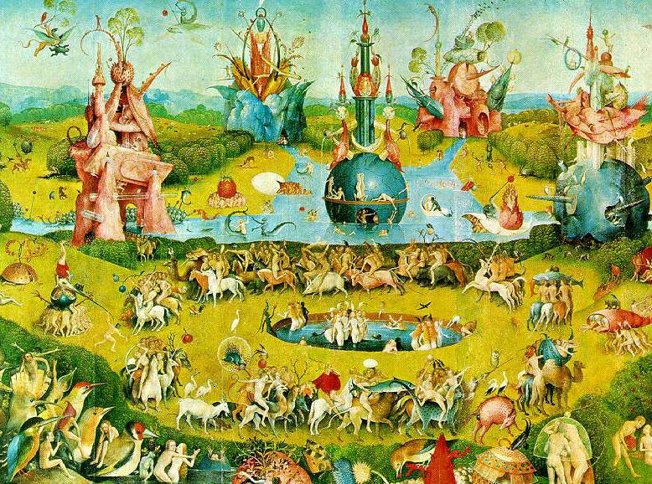
E N D E

